Slide 1
SUMMER TRAINING REPORT
Institute /Company Name: CISCO NETWORKING ACADEMY
Resource Person: PRERANA DEWANGAN
Duration : 1 MONTH
Student Name : SHUBHAM KUMAR SINGH
SECTION : CSE (AI)
University Roll No: 301411322001

Slide 2
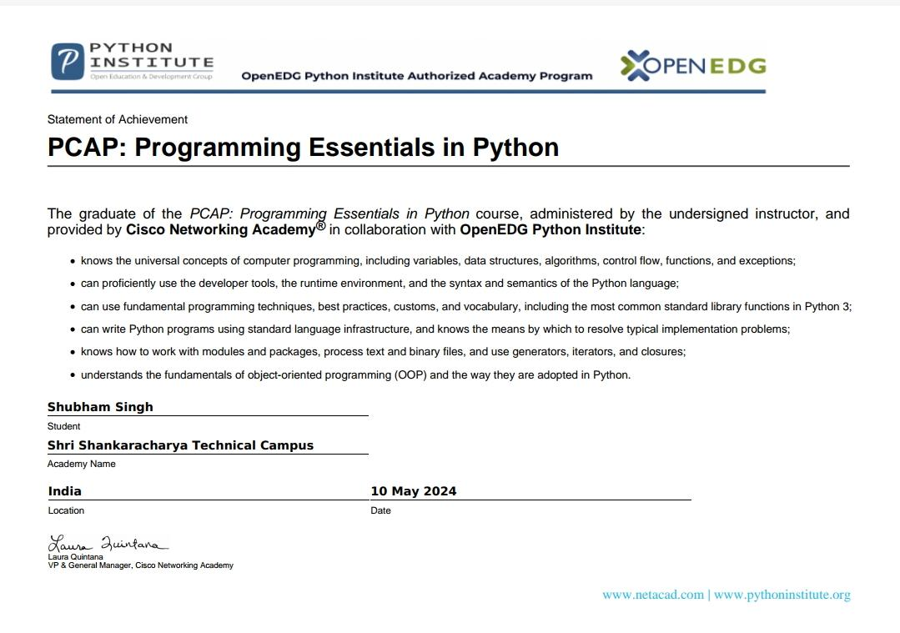
VOCATIONAL TRAINING CERTIFICATE

Slide 3
INTRODUCTION
The 1 Month Programming Essentials in Python provided by Cisco Networking Academy was an immersive and hands-on training program designed to provide participants with foundational skills in web development. The primary goal of the bootcamp was to recreate the user interface (UI) of Instagram—a widely used social media platform—using only Python . This project-focused approach allowed participants to apply theoretical knowledge to a real-world application, fostering a deeper understanding of web design principles.

Slide 4
TECHNOLOGY
Python is used across various technologies, including web development with frameworks like Django, Flask, and FastAPI. For data science, libraries such as NumPy, Pandas, and TensorFlow are popular. It powers automation through tools like Selenium and BeautifulSoup, while in game development, libraries like Pygame are common. Python supports embedded systems with MicroPython, and for desktop apps, Tkinter and PyQt are widely used. It’s also prominent in DevOps (e.g., Ansible), cloud computing (AWS, Google Cloud), and testing (PyTest). Python excels in natural language processing with NLTK and spaCy and supports databases via SQLAlchemy and MongoDB.

Slide 5
Technology Covered
Python is utilized across a wide range of technologies, making it a versatile language in various domains:
*Web Development*: - *Frameworks*: Django, Flask, FastAPI, Pyramid - *Libraries*: Jinja2 (templating), SQLAlchemy (ORM), Celery (task queues)
2. *Data Science & Machine Learning*: - *Libraries*: NumPy, Pandas, Matplotlib, Seaborn (visualization), SciPy (scientific computing), Scikit-learn (machine learning), TensorFlow, PyTorch (deep learning) - *Tools*: Jupyter Notebooks, Keras (deep learning API)
3. *Automation & Scripting*: - *Libraries*: Selenium (web automation), BeautifulSoup (web scraping), Requests (HTTP requests), Paramiko (SSH connections)
4. *Game Development*: - *Libraries*: Pygame, Panda3D, Godot (with Python scripting)
t

Slide 6
ABOUT YOUR TRAINING
During my 1 Month Python program its providing practical, industry-relevant skills for careers in software development, web development, data science, and automation. Key topics include:
1. *Basic Python Syntax*: Learning variables, data types, control structures, and functions.
2. *Object-Oriented Programming (OOP)*: Understanding classes, objects, inheritance, and polymorphism.
3. *Web Development*: Building applications with frameworks like Django and Flask.
4. *Data Science*: Using libraries like Pandas, NumPy, and Matplotlib for data analysis and visualization.

Slide 7
5. *Automation*: Automating tasks with libraries like Selenium and BeautifulSoup.
6. *Database Interaction*: Working with SQL and NoSQL databases.
7. *Software Tools*: Version control (Git), IDEs (PyCharm), and testing frameworks (unittest, PyTest).
8. *Projects*: Real-world projects to build a professional portfolio.
The training combines theoretical knowledge with hands-on practice, preparing learners for job-ready positions in tech.

Slide 8
CONCLUSION
Learning Python offers a versatile and beginner-friendly introduction to programming. Its simple syntax makes it ideal for beginners, while its powerful libraries and frameworks support advanced applications in fields like web development, data science, machine learning, automation, and more. Python's active community and extensive documentation make it easy to find resources and solutions. As a high-level language, it allows developers to focus on problem-solving rather than technical details, enhancing productivity. Overall, mastering Python equips you with essential programming skills applicable across various industries, making it a valuable tool for both personal projects and professional growth.

Slide 9
Thank you
I am deeply grateful for the opportunity to participate in the 1 month bootcamp focused on programing Essentials in Python. This training was an incredible learning experience, equipping me with practical skills in web development, including structuring webpages, designing responsive layouts, and styling elements to match a real-world application. The hands-on approach, coupled with expert guidance and detailed feedback, allowed me to build confidence in using Python effectively. I extend my heartfelt thanks to the instructors, mentors, and my peers for their support and collaboration throughout this enriching journey. Thank you!

